Slide 1
WA GMA Public Works
Surveying Data — Initial Descriptive Statistics Report
17 out of 39 entities surveyed
11 Washington counties · 9 survey questions
An overview of how various Washington public works staff perceive growth, plan infrastructure, and fund expansion

Slide 2
1. Alright, for starters what is your formal title in relation to [city] , [name]? 2. Do you happen to know the GMA status of your county? 3. Would you say the population of [city] has grown significantly in the last 10 years? 4. Does your town sell or provide water to any neighboring towns? 5. Has your department needed to expand the water infrastructure for your city at any point in the last 10 years? 6. How does your department raise funds for expansions of water infrastructure? Do you levy any upfront fees, like system development charges or capacity fee charges? 7. How are those funding methods typically calculated? For instance, do certain factors change how much the customer or developer on your water network pays? 8. Does your department utilize a GIS tool for your town’s water meters? If so, is this used when calculating fees and bills? 9. Is there anything you would like to add that you think may be helpful on this matter?
The Survey
Goal: Find towns in a similar spot to White Salmon, get an idea of how they handle their water infrastructure costs
9 questions
WA GMA Public Works Survey | Descriptive Statistics
2 / 11

Slide 3
White Salmon
In Klickitat county, which is a partial planning Growth Management Act (GMA) county
Sells water outside of city limits to the town of Bingen
Has funded multiple water infrastructure expansion projects within the last 10 years
Population growth of 5.99% within the last 10 years (2,420 → 2,565)
These characteristics shape the sample selection, questions asked in the survey, and how those answers are interpreted
WA GMA Public Works Survey | Descriptive Statistics
2 / 11

Slide 4
Sample composition
39 entities · 11 counties · 16 useful responses
All towns and PUDs sampled are from the 11 partial-planning GMA counties in WA state.
39 out of 42 towns and county-level entities contacted across Washington (no surveying in Klickitat county to avoid skewing data)
17 surveys (40.5%) yielded useful, codable participation
Two entries are county-level “Public Utilities Districts" rather than incorporated towns
Surveys per county
Attempted surveys per county
WA GMA Public Works Survey | Descriptive Statistics
2 / 11

Slide 5
General Findings
Four patterns that recur across the survey
01
Minor infrastructure expansion within the last 10 years is the norm
All 11 expanders added connections, 4 had more major infrastructure projects.
02
GMA awareness is low
All 11 counties in the sample are partial planning, a little more than half of the PWDs weren’t aware of that.
03
Funding is heterogeneous – but mostly utilizes some form of upfront development fee
No dominant mechanism; CFCs and impact fees rare; SDCs, connection fees, and grants more common.
04
GIS is widespread but narrow
81% use GIS tools — almost all for meter location, more sparingly for fee modeling or asset valuation.
WA GMA Public Works Survey | Descriptive Statistics
10 / 11

Slide 6
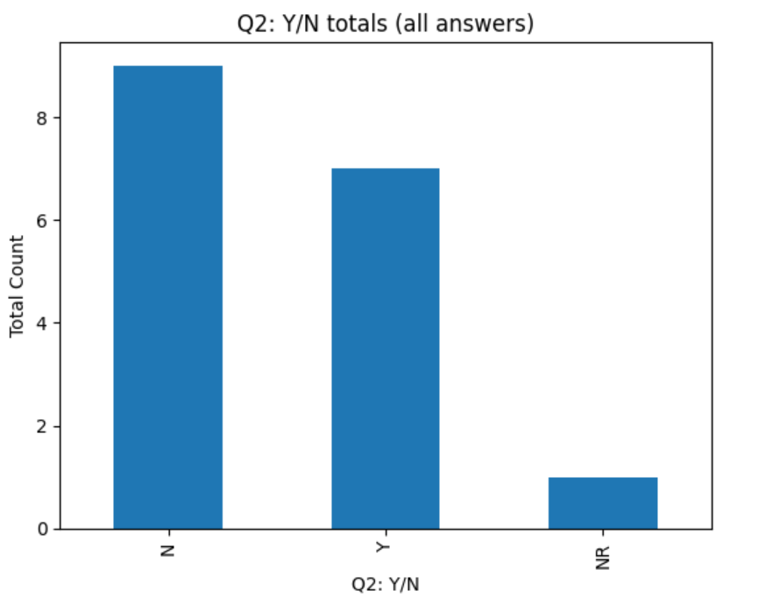
Q2 — Knowledge of GMA status
Self-reported awareness vs. fact-checked reality
Among useful respondents: 7 of them knew, 9 of them did not
More than half of all public works staff surveyed didn't know their county's GMA standing
Fact-check: every one of the 11 counties is "partially planning" under GMA
Implication: GMA status is mostly invisible to operators day-to-day, even when it formally applies
This is worth noting when looking at funding outliers
Knowledge of GMA status?
WA GMA Public Works Survey | Descriptive Statistics
3 / 11

Slide 7
Q3 — Population growth: White Salmon as reference
Towns that grew at or above White Salmon's pace (OFM 2015 → 2025)
White Salmon WA grew 5.99% over the decade (2,420 → 2,565)
6/17 surveyed towns had a population growth above White Salmon’s
Self reported population growth was mostly inaccurate: Only 4 of 17 useful respondents reported feeling population growth in Q3
Surveyed Towns at or above White Salmon's 5.99% growth
County | Town | Pre-growth population [2015, per OFM] | Current population [2015, per OFM] | Population growth
Adams | Othello | 7780 | 9210 | 18.38046272
Asotin | Clarkston [Asotin PUD] | 7235 | 7240 | 0.0691085
Cowlitz | Longview | 37130 | 38310 | 3.178023162
Cowlitz | Woodland | 5845 | 6585 | 12.6603935
Ferry | Republic | 1090 | 1000 | -8.256880734
Grays Harbor | Aberdeen | 16780 | 17200 | 2.502979738
Grays Harbor | Elma | 3135 | 3535 | 12.75917065
Klickitat | White Salmon | 2420 | 2565 | 5.991735537
Lincoln | Davenport | 1685 | 1720 | 2.077151335
Lincoln | Wilbur | 880 | 895 | 1.704545455
Okanogan | Omak | 4900 | 4985 | 1.734693878
Okanogan | Oroville | 1695 | 1820 | 7.374631268
Okanogan | Tonasket | 1110 | 1090 | -1.801801802
Okanogan | Pateros | 525 | 610 | 16.19047619
Okanogan | Winthrop | 435 | 605 | 39.08045977
Skamania | Skamania (PUD) | 11430 | 12150 | 6.299212598
WA GMA Public Works Survey | Descriptive Statistics
4 / 11

Slide 8
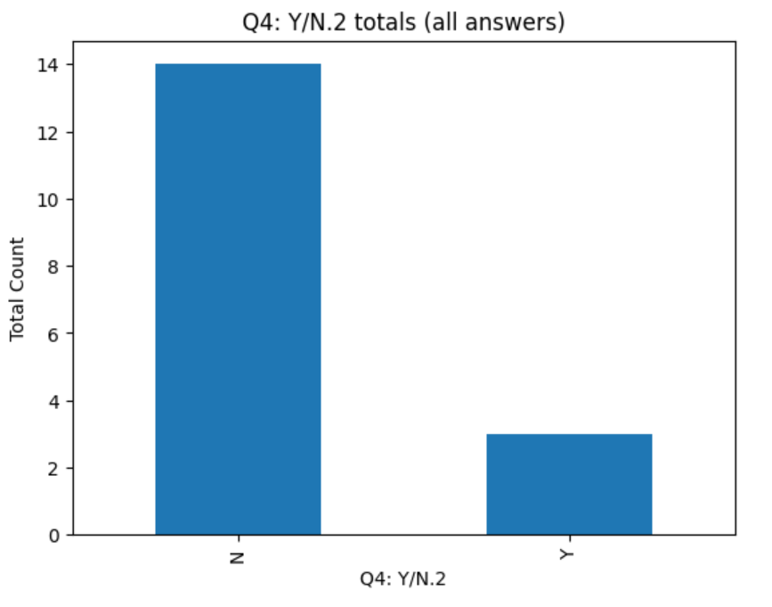
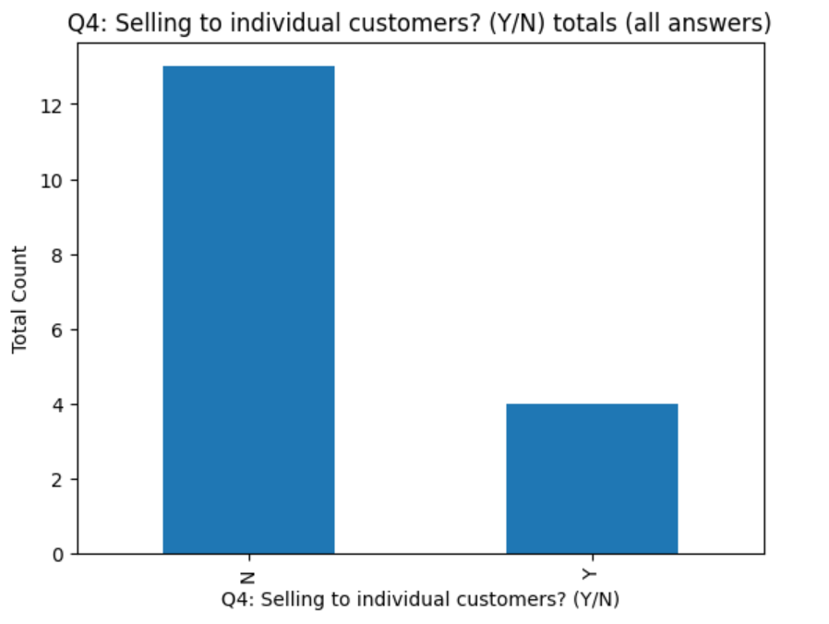
Q4 — Selling water to other towns
Inter-municipal water sales are uncommon in this sample
Water sales to other towns:
14 out of 17 respondents (82%) do not sell water outside of their service boundaries
4 respondents (23.5%) reported some form of inter-municipal water sale, with overlap on town sales vs other sales (often to individual customers)
Consistent with the rural, low-density profile of the sample
Where it does happen, it often reflects shared aquifer or PUD-style arrangements
County | Town | Selling water to other towns? (Y/N) | External water sales to individuals? (Y/N)
Asotin | Clarkston [Asotin PUD] | Y | Y
Cowlitz | Longview | Y | N
Cowlitz | Woodland | Y | N
Okanogan | Tonasket | N | Y
Okanogan | Winthrop | N | Y
Skamania | Stevenson | N | Y
Water sales to individual customers:
WA GMA Public Works Survey | Descriptive Statistics
6 / 11

Slide 9
Q5 — Recent infrastructure expansion
Most towns have expanded — but only on connections
11 of 17 respondents (65%) reported recent infrastructure expansion
All 11 expanders added connections — but few added supply or treatment capacity
No water treatment expansions in the past decade (of the towns surveyed)
Suggests these systems are densifying use of existing supply rather than growing capacity
Towns & PUDs expanding water infrastructure
Type of expansion (among 10 expanders)
County | Town | Water infrastructure expansion in last 10 years? (Y/N)
Adams | Othello | Y
Asotin | Clarkston [Asotin PUD] | Y
Cowlitz | Longview | Y
Cowlitz | Woodland | Y
Grays Harbor | Elma | Y
Lincoln | Wilbur | Y
Okanogan | Omak | Y
Okanogan | Pateros | Y
Okanogan | Winthrop | Y
Skamania | Skamania County PUD | Y
Skamania | Stevenson | Y
WA GMA Public Works Survey | Descriptive Statistics
7 / 11

Slide 10
Q6 — How expansion is funded
Connection fees, SDCs, and grants dominate; impact fees and CFCs are rare
9 of 17 respondents (53%) provided funding-mechanism detail, involving an explicit understanding of the calculations used for them
Funding tool mix varies by town; no single mechanism dominates the field:
Most common: connection fees and SDCs (4 each), grants (4), and "other/edge case” arrangements (4)
CFCs are uncommon
1 town levying impact fees is an interesting outlier (partial-GMA status tends to disallow this practice)
Funding mechanisms used
WA GMA Public Works Survey | Descriptive Statistics
8 / 11

Slide 11
Q7 & Q8 — Fee calculations and GIS tool use
Most use overall cost analysis; GIS is widespread but narrow
Most common basis: overall cost analysis (4); ERUs cited just once
Only a handful of the people I surveyed knew the precise nature of HOW their funding methodology is calculated
Q8: 13 of 17 respondents (81%) use a GIS tool — high adoption
GIS is used almost universally for meter location, but only around 50% of the time for asset valuation
3 towns use a separate tool for their asset valuation
Q7: Fee calculation basis
Q8: GIS tool use cases
WA GMA Public Works Survey | Descriptive Statistics
9 / 11

Slide 12
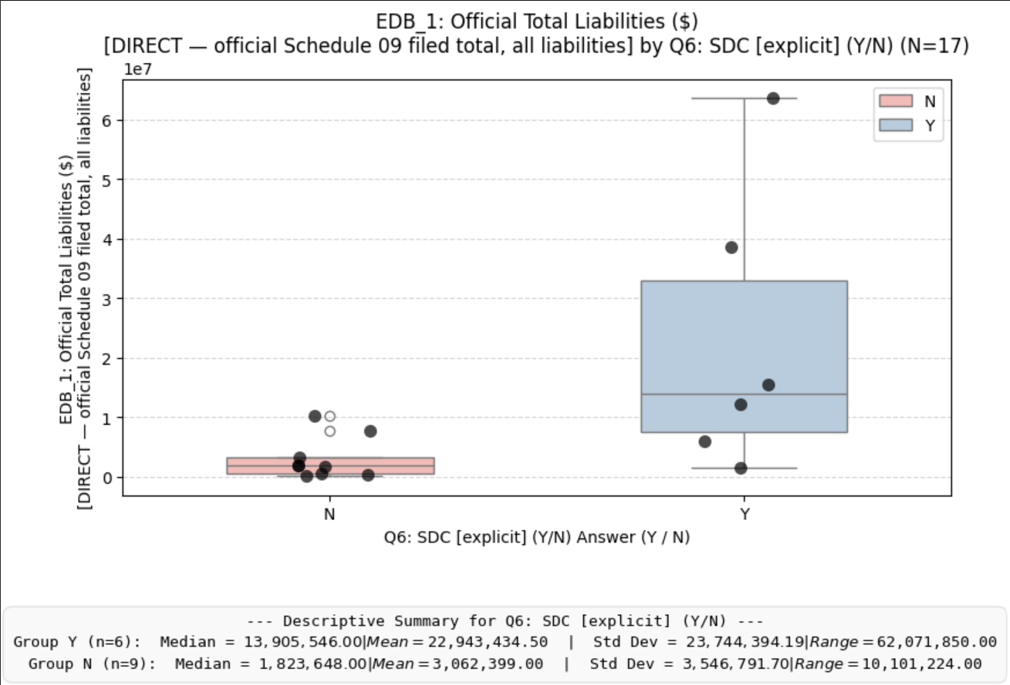
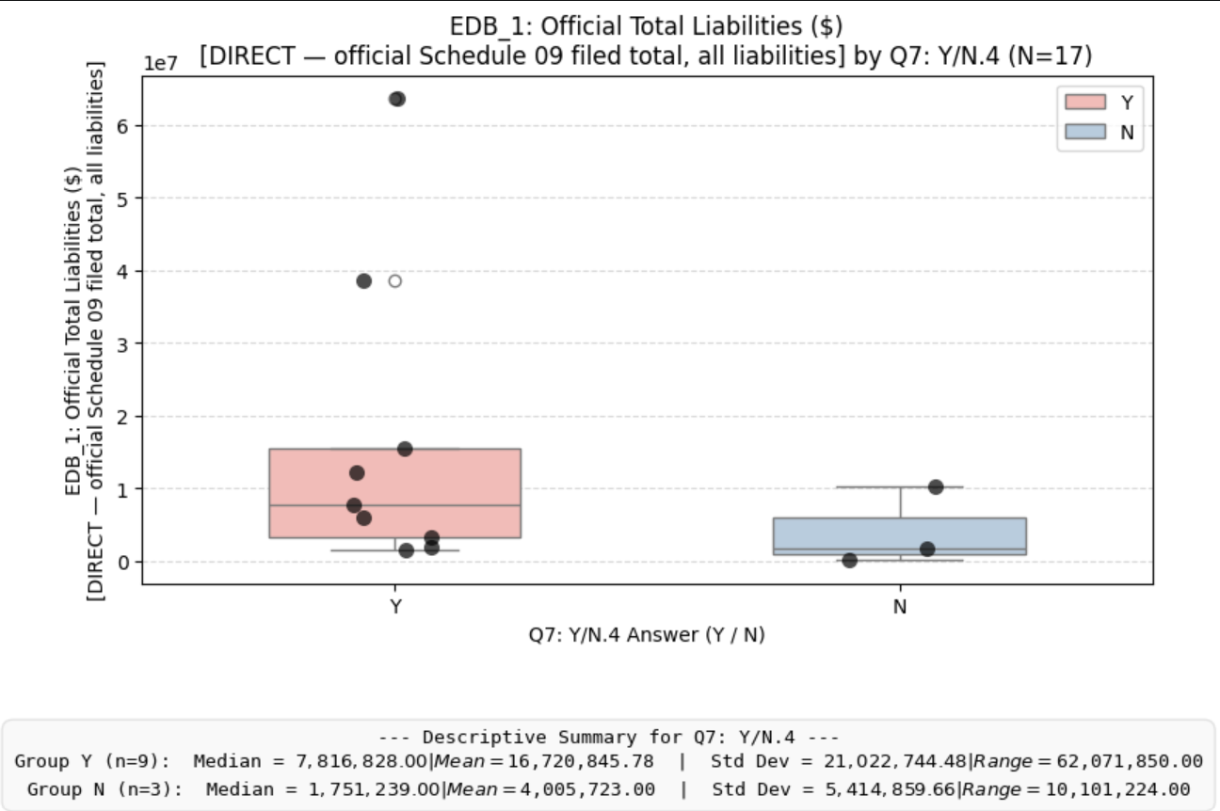
Q6: SDC use? (Y/N) as it correlates with high town debt
Mann-Whitney (U) testing
Finding correlations between different Y/N responses and Overall Town debt
Potential correlation between higher town debt and SDC adoption
Potential correlation between higher town debt and higher level of funding methodology calculation knowledge
In general:
Debt data is from 2024, as that is what is most recently available
P-values are low for both -> correlation can’t be proven reliably for either U-test
Correlation != Causation
Ex: More people skiing doesn’t cause more snow to fall -> logic dictates how we interpret the relationship here
Q7: Upfront fee calculation knowledge? (Y/N) as it correlates with high town debt
WA GMA Public Works Survey | Descriptive Statistics
9 / 11

Slide 13
Methodology & caveats
Reading these descriptive statistics responsibly
Sample is purposive, not random: 39 small, rural Washington towns (and 2-3 county-level PUDs among them). Findings don't generalize to urban or large-suburban utilities.
Response rate for useful data was 17 / 39 (41%).
Self-reported categorical answers (Y/N) carry my interviewer-coding judgment, especially on Q5 and Q6 where sub-mechanisms were sometimes inferred from open-ended explanation.
A more comprehensive time-series analysis would be necessary to prove true correlation between funding method and effective debt alleviation
Source: WA_GMA_PW_Surveying_Data_Collection.xlsx, 'Full Survey Table' sheet

